Slide 1
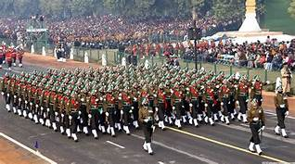
INDIGENISATION NEEDS & CHALLENGES
BY
DIRECTORATE OF INDIGENISATION (ARMY)

Slide 2
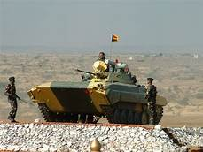
AIM
To
Give insight into a comprehensive plan to synchronize latest development of Engineering with actual requirements of industries to assist in
Capability Building

Slide 3

PREVIEW
TECHNOLOGY PROLIFERATION
DOI : ROLE , ORGANISATION
INDIGENISATION PROCESS
SUCCESS STORIES VS CRITICAL TECH
CHALLENGES & WAY FORWARD
UPCOMING PROJECTS
INDUSTRY PARTICIPATION
CONCLUSION

Slide 4

STAKE HOLDERS
Defence Industry
Defence Forces
DRDO
OFBs & DPSUs
Private Industry
Capability Enhancement : Design & Build
Notes:
Each of the first three, want to take a different
road. Each one is correct and each one is wrong.
There is no consensus of approach. The military
wants the latest operational equipment that is only
available abroad. The DRDO/DPSU combine wants
the armed forces to accept what they produce. The
private sector feels left out. The fourth one lacks
the understanding of the issues. The fifth is passive
and perhaps indifferent as well. Since no consensus
is obtaining the omnibus has driven itself mostly
along the fourth road i.e. ‘the nowhere road.’

Slide 5
DIRECTORATE OF INDIGENISATION (ARMY)
  To build a strong and reliable indigenous defence production base for manufacture of spare parts / assemblies / sub-assemblies/ systems/ sub systems of imported equipment which are not being indigenised by Ordnance Factory Board /Defence Public Sector Undertakings
  Nodal point in the Integrated Headquarters of MoD (Army) for indigenisation of spare parts/ assemblies / sub-assemblies

Slide 6
ROLE
  To carry out indigenisation of imported stores pertaining to the following disciplines:-
    Vehicle Stores
    Electrical & Electronic Stores
    Armament Stores
    Engineer Equipment Stores

Slide 7
ORGANISATIONAL STRUCTURE
DOI
Indigenisation
Committee
(Vehicle)
Indigenisation
Committee
(Armament)
Indigenisation
Committee
(Electronics)
Indigenisation
Committee
(Engineering
Equipment)
Drawing &
Specification Wing
(Vehicle)
Pune
Drawing &
Specification Wing
(Armament)
Jabalpur
Drawing &
Specification Wing
(Electronics)
Bangalore
Drawing &
Specification Wing
(Engineering
Equipment)
Pune

Slide 8
INDIGENISATION PROCESS
  Governed by Chapter 15 of DPM 2009
Genr of Reqmt
Display & Selection of Items
Prep of Drgs & QAIs
Selection of L1 Vendor
Receipt of Bids
Tender Publication
Contract Conclusion with L1
Finalisation of Drgs
Pilot Sample Evaluation
Submission of Bills to CDA
Bulk Prod Clearance

Slide 9
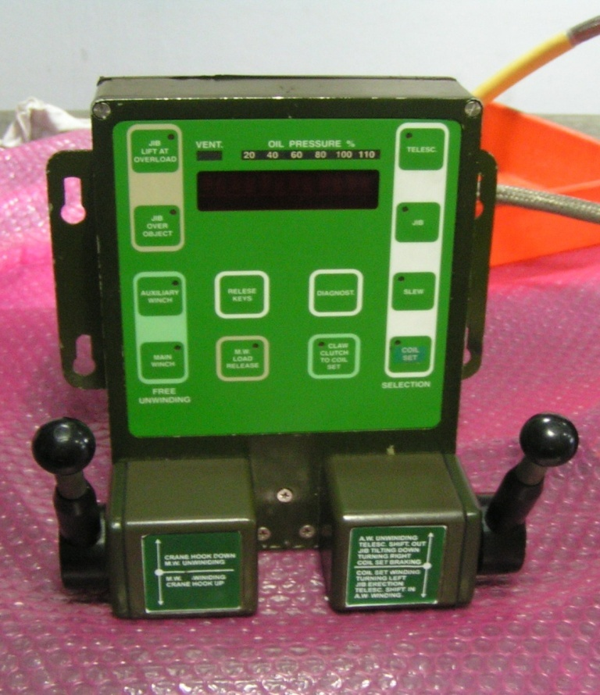
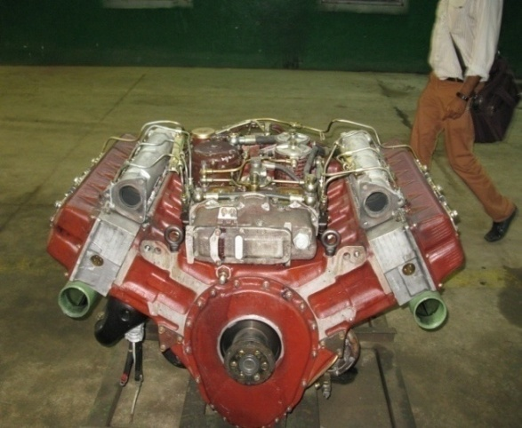
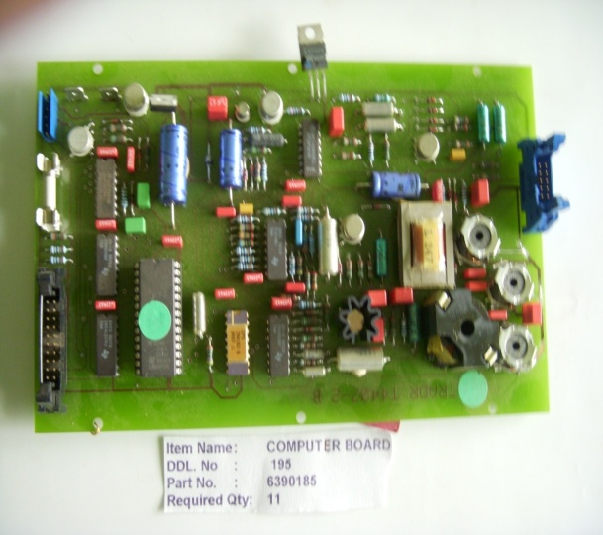
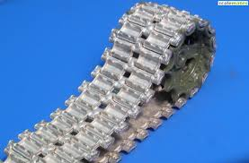
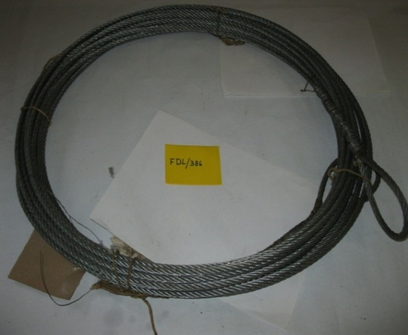
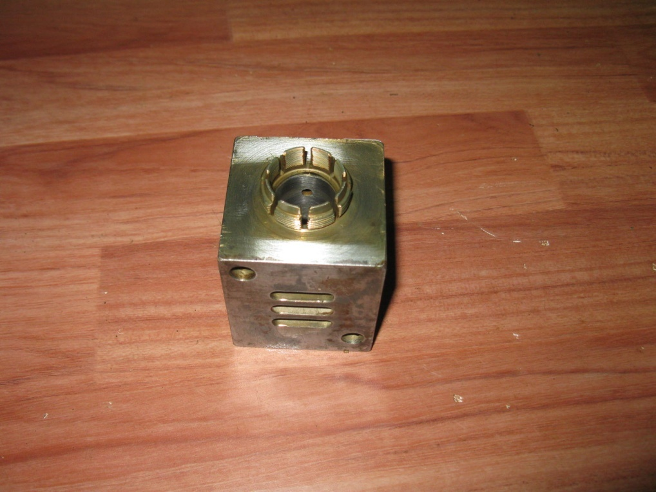
Items under Indigenisation : 2886
Items successfully Indigenised : 570
Notes:
9

Slide 10
PLATFORM WISE INDIGENISATION
Platform | % of Items under Indigenisation
ARMAMENT | 48.89%
AIR DEFENCE WEAPON SYSTEM | 15.87%
SPECIAL VEHICLE | 14.68%
‘A’ VEHICLE | 10.18%
SMALL ARMS | 8.43%
ARMOURED RECOVERY VEHICLE | 1.95%

Slide 11
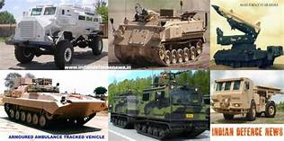
SUCCESS STORIES VS
CRITICAL TECHNOLOGIES
Material
Engines
Electronics
Notes:
Each of the first three, want to take a different
road. Each one is correct and each one is wrong.
There is no consensus of approach. The military
wants the latest operational equipment that is only
available abroad. The DRDO/DPSU combine wants
the armed forces to accept what they produce. The
private sector feels left out. The fourth one lacks
the understanding of the issues. The fifth is passive
and perhaps indifferent as well. Since no consensus
is obtaining the omnibus has driven itself mostly
along the fourth road i.e. ‘the nowhere road.’

Slide 12

MATERIAL TECHNOLOGY

Slide 13
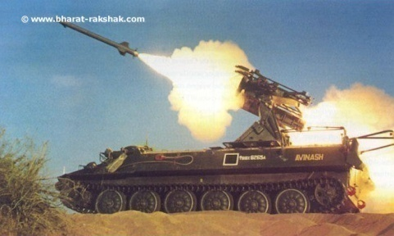
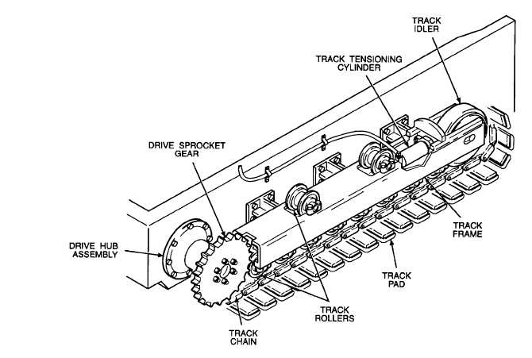
TRACK ASSEMBLY : STRELLA 10M
Brief description: Track assembly mounted on road wheel. Drive from sprocket for easy rolling
Low Population & Imported
Production line closed
Developed through Indian Vendor
Metallurgical & Technical expertise achieved Indigenously

Slide 14
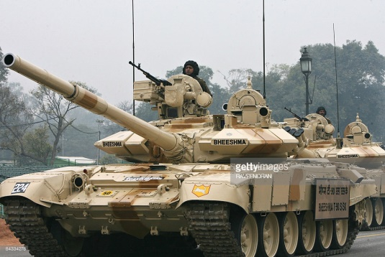
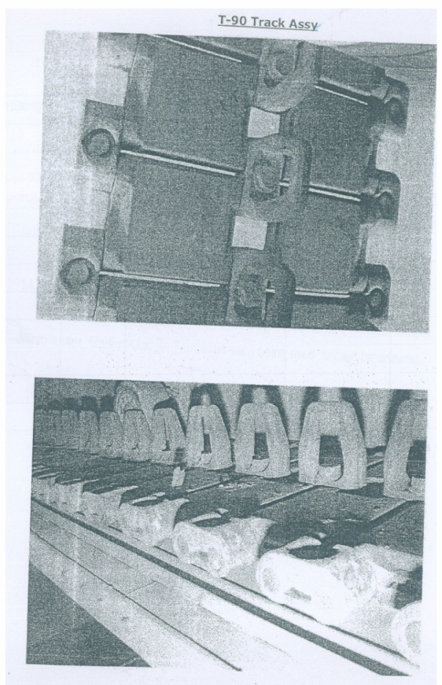
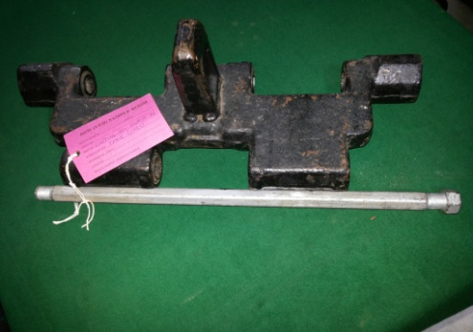
TRACK ASSEMBLY : TANK T-90
Brief description: Track assembly mounted on road wheel. Drive from sprocket for easy rolling
Extensively exploited leading to frequent breakdown
Import dependence not cost effective
Self – Reliance & Forging capability enhanced

Slide 15
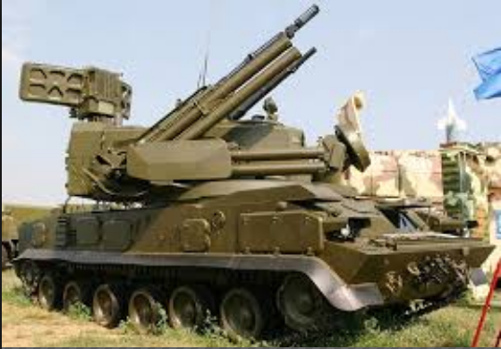
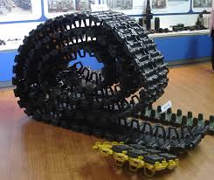
TRACK ASSEMBLY : TUNGUSKA
Brief description: Track assembly mounted on road wheel. Drive from sprocket for easy rolling
Import origin, track not available due to production line closure
Low Population equipment and sustenance difficult
Sustenance of Low Population Equipment being addressed

Slide 16
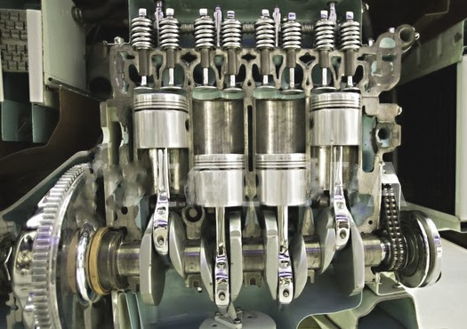
ENGINES

Slide 17
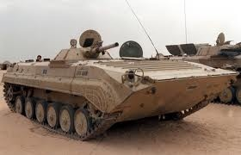
POWER PACK : INFANTRY COMBAT VEHICLE BMP - II
Need felt to upgrade BMP engine from 280 HP to 360 HP
Change transmission from manual to auto
Modular design
Six vendors participating in trials
Technology Upgrade with simultaneous Technology insertion

Slide 18
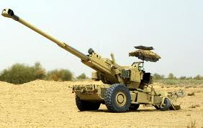
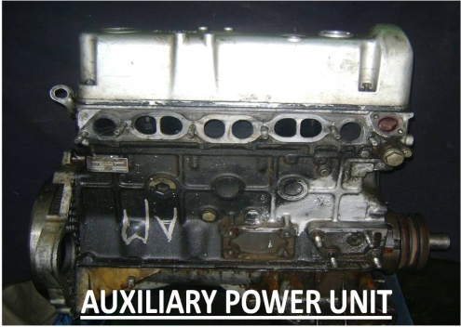
AUXILIARY POWER UNIT : BOFORS
Brief description: Auxiliary Power Unit for self propulsion
Major import substitution @ 5 lakhs against 47 lakhs of imported engine
Major Import Substitution & Cost Saving

Slide 19
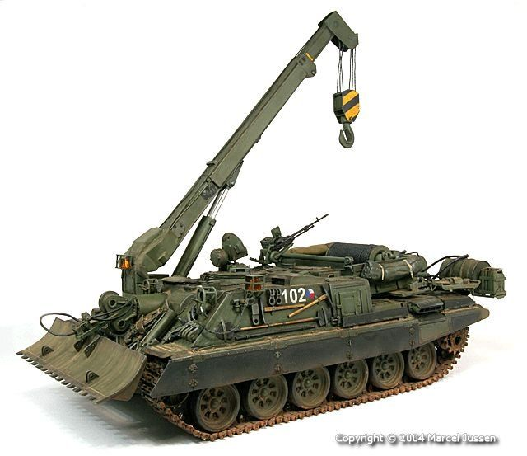
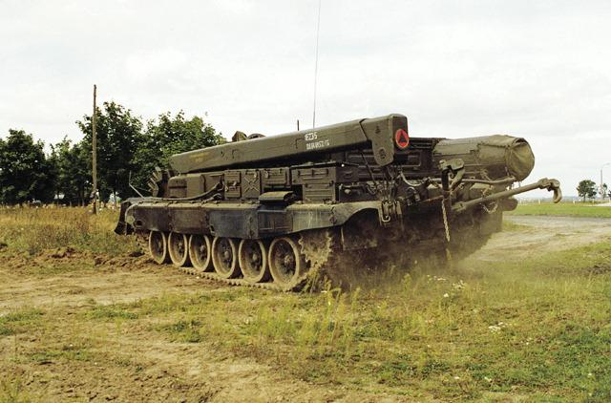
ARMOURED RECOVERY VEHICLE : VT-72B
Vintage – 18 to 24 yrs and overdue for base overhaul
OEM facility shut down leading to non availability of spares
Case initiated for indigenisation of utility portion
Platform based Indigenisation with 15 Years product support

Slide 20

ELECTRONICS

Slide 21

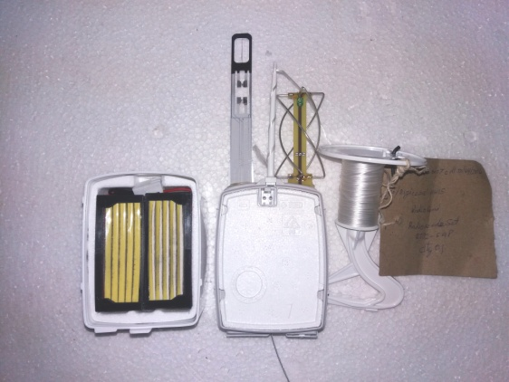
ARTILLERY METEOROLOGICAL SYSTEM
RADIO SONDE
  Need felt to indigenise Arty Met Sys due to high cost of spares from OEM
  EoI for NCNC devp of Arty Met Sys uploaded in May 2018
Industries’ keenness to participate even on NCNC basis

Slide 22


Slide 23

CHALLENGES
Obsolescence Mgt : Need for Technology Upgrade / Redesign
Long Gestation Period & Intricate Procurement Process
Foreclosure of SO due to non delivery
R&D – Timeline & Cost for complex Assembly / Sub-assembly
Uneconomical volumes

Slide 24
WAY FORWARD
Indigenisation to target newly inducted equipment
Indigenisation to focus on major assembly/ sub-assembly
Indigenisation based on import list

Slide 25

UPCOMING PROJECTS

Slide 26
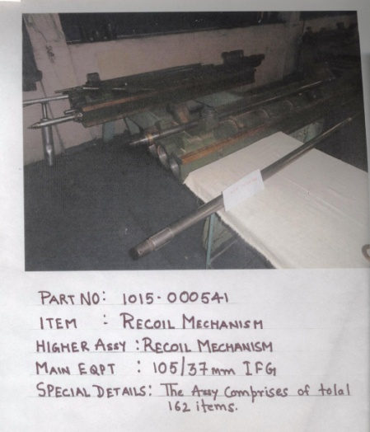
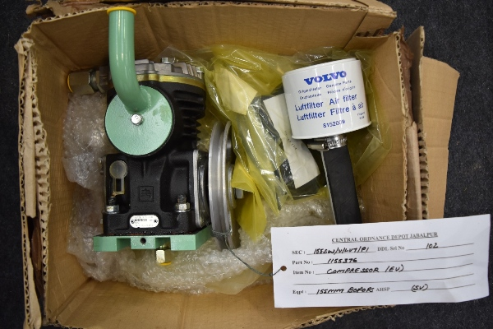
CRITICAL ASSEMBLY UNDER DEVELOPMENT
Nomenclature – Recoil Mechanism
Main Eqpt – 105/37MM IFG
Nomenclature – Compressor EU
Main Eqpt – BOFORS GUN

Slide 27
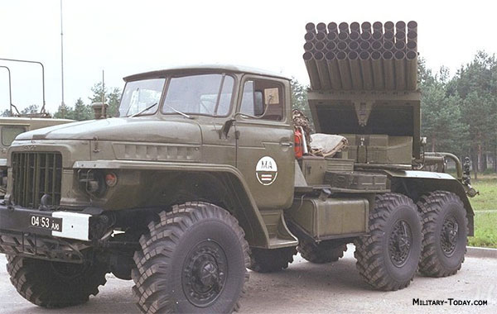
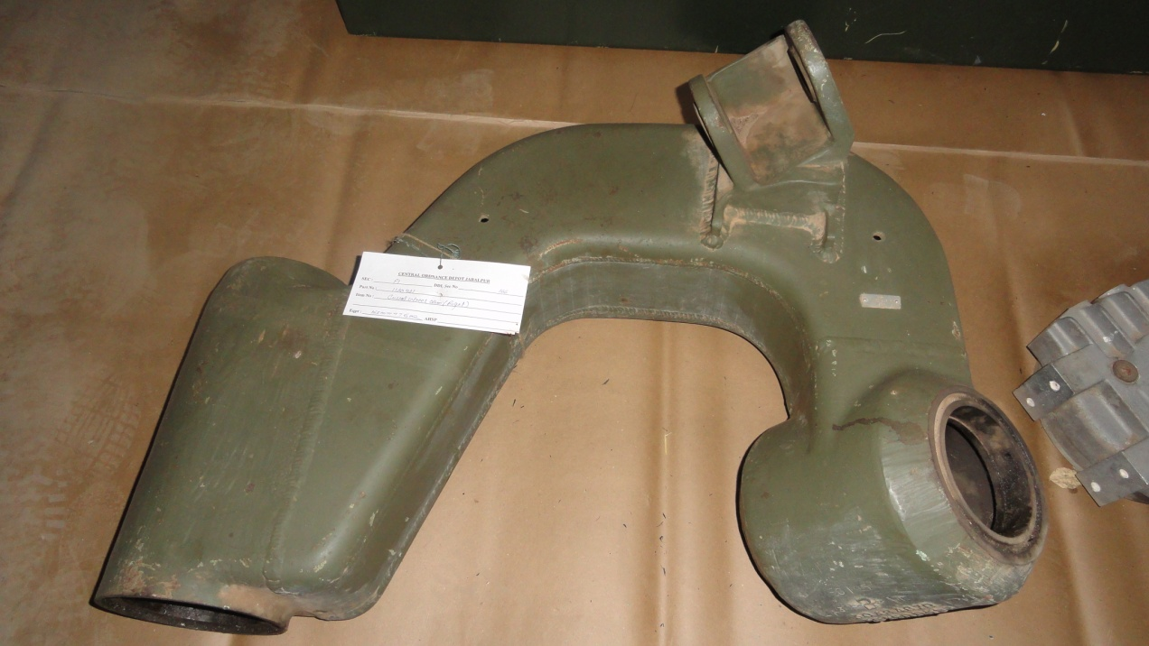
CRITICAL ASSEMBLY UNDER DEVELOPMENT
Nomenclature – Barrel/ Tube
Main Eqpt – 122MM Grad BM-21
Nomenclature – Castor Wheel Arm
Main Eqpt – BOFORS GUN

Slide 28
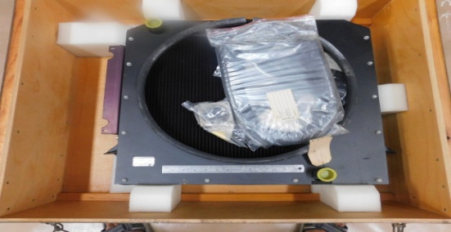
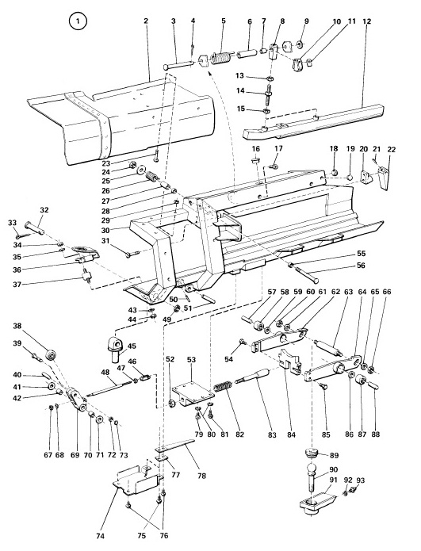
CRITICAL ASSEMBLY UNDER DEVELOPMENT
Nomenclature – Radiator
Main Eqpt – BOFORS GUN
Nomenclature – Loading Tray
Main Eqpt – BOFORS GUN

Slide 29
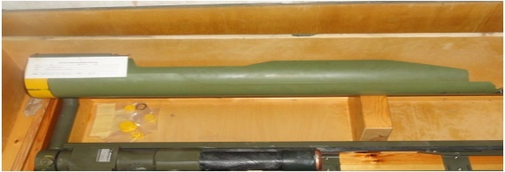
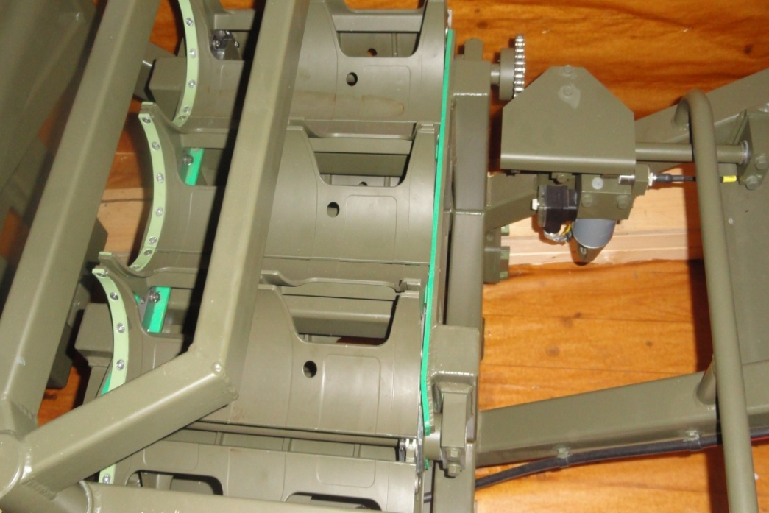
CRITICAL ASSEMBLY UNDER DEVELOPMENT
Nomenclature – Rammer Unit
Main Eqpt – BOFORS GUN
Nomenclature – Loading Table
Main Eqpt – BOFORS GUN

Slide 30
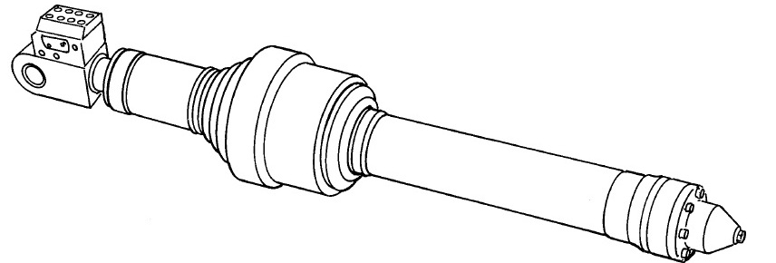
CRITICAL ASSEMBLY UNDER DEVELOPMENT
Nomenclature – Elevating Cylinder
Main Eqpt – BOFORS GUN

Slide 31
INDUSTRY PARTICIPATION

Slide 32
SCHEDULE OF INDIGENIZATION SUB COMMITTEE MEETING : 2018
Ser No | Venue | Equipment | Date : ISC meet
1 | CAFVD, KIRKEE | T-72, T-90, ICV BMP , SPECIAL VEHICLES | DEC 2018
2 | CASD DELHI CANTT | UAV SEARCHER MK-IA & MK- II & HERON | BEING PLANNED

Slide 33
HOW TO PARTICIPATE
Central Public Procuement Portal (https://eprocure.gov.in)
  Visit CPP Portal and search for DOI to locate all the active RFPs of DOI
  All cases are dealt as e-procurement only
Link to DoI webpage
  https://indianarmy.nic.in Directorate/ Branches DOI
  Shortcut (http://goo.gl/tt2jyt)

Slide 34
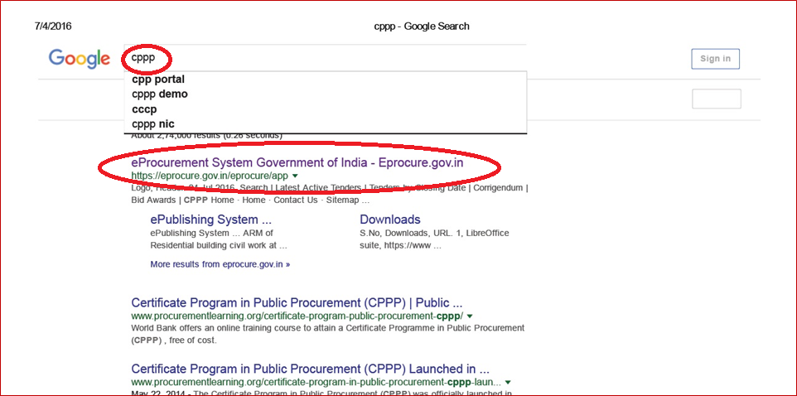
ACTIVE RFP ON WEB

Slide 35
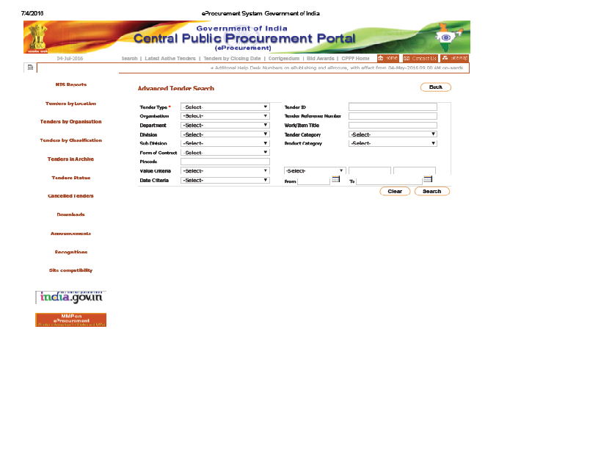
ACTIVE RFP ON WEB

Slide 36
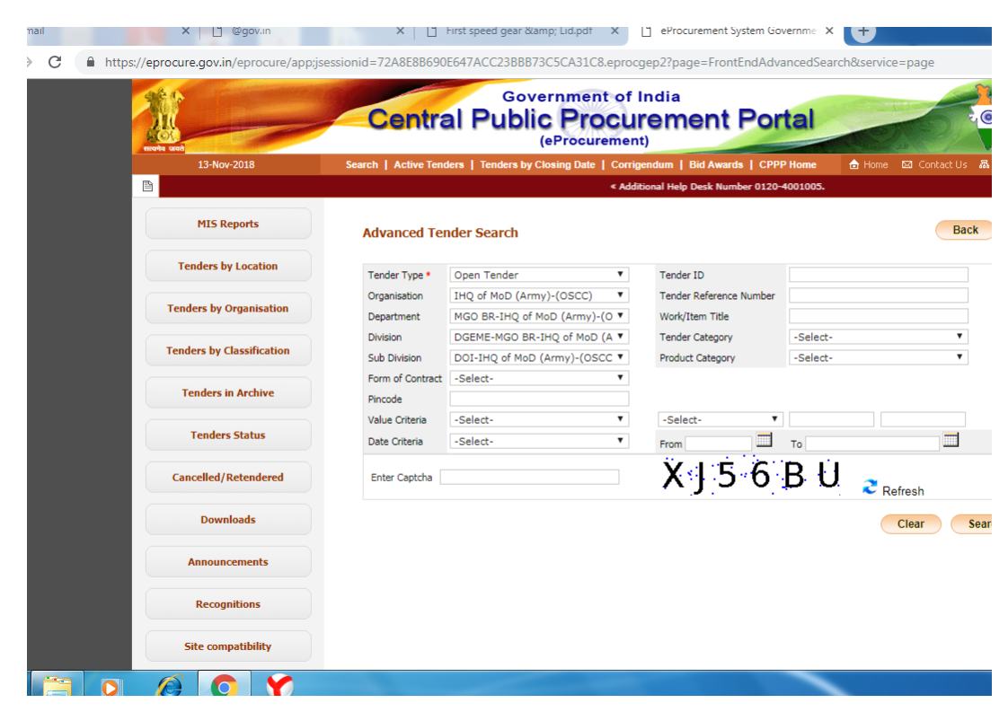
ACTIVE RFP ON WEB

Slide 37
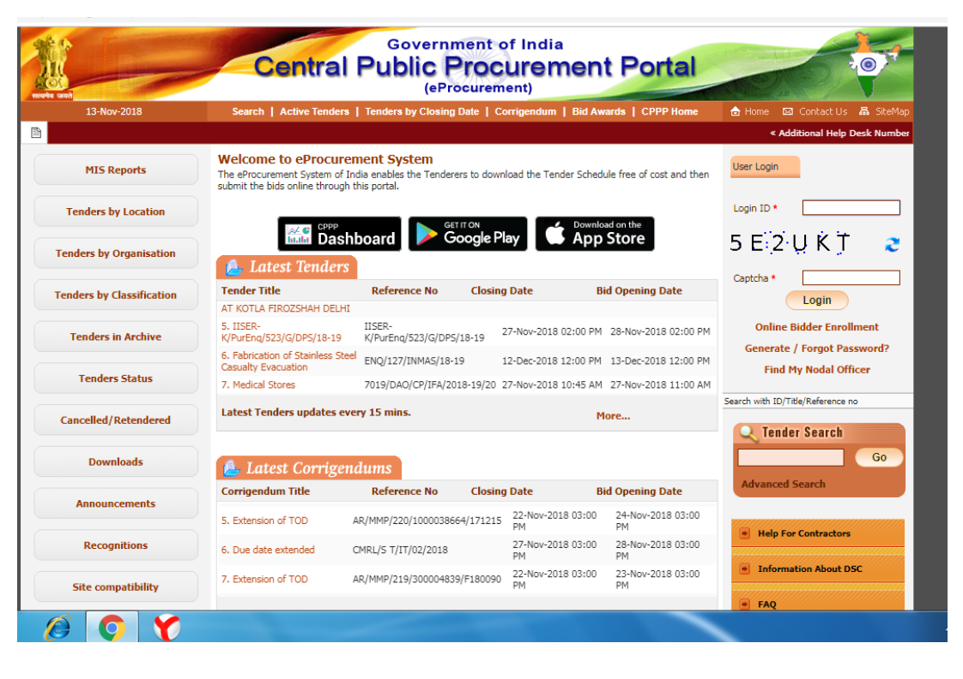
ACTIVE RFP ON WEB

Slide 38
ADVANTAGES OF INDIGENISATION THROUGH DOI FOR VENDORS
Registration with DOI not mandatory. EMD not required if registered with any govt agency
One time development cost paid in full to successful bidder
Transparent bidding through on line e-proc portal. RFPs uploaded with photos, QAIs and Drgs
All available drawing, sample, specification and know how shared free of cost
Upgradation of technology and black box approach permissible
Parallel development by two sources to ensure free flow
EOQ is considered for indigenisation and commitment for subsequent orders from developed source

Slide 39
CONCLUSION

Slide 40

CONCLUSION
Attainment of Vibrant Defence Industry will ensure
  Strategic Independence
  Sovereign Capability in selected areas
  Cost Effective Defence Equipment
  Collateral benefits ensuing from the endeavours of the defence industry

Slide 41

JAI HIND

